Slide 1
STATISTIC ANALYSIS OF BIG DATA
Date:
Presenter: PHAN THI THU TRANG
Department: Business Administration

Slide 2

TABLE OF CONTENTS
03
ANALYSIS
CONCLUSION
01
02
Introduction

Slide 3

House Price Prediction in King County
King County is located in the U.S. state of Washington. The population was 2,269,675 in the 2020 census,^{[1]} making it the most populous county in Washington, and the 13th-most populous in the United States.
KING COUNTY
US
King County, Washington - Wikipedia

Slide 4
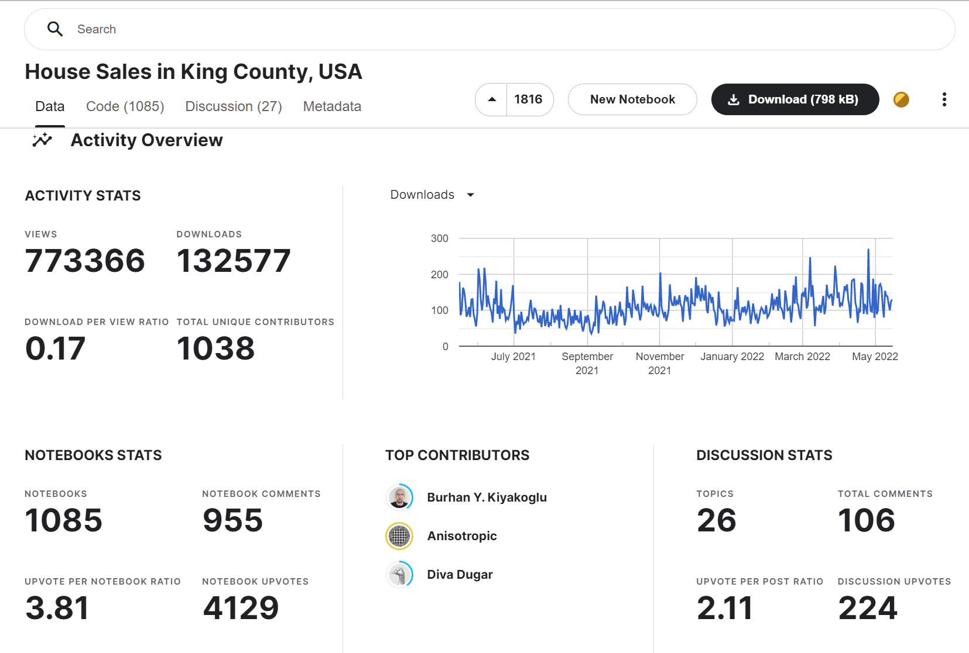
DATA SOURCE
House Sales in King County, USA | Kaggle

Slide 5
PROJECT OBJECTIVE
Predict house prices in King County, and the factors that affect King County’s house prices.

Slide 6
Data Exploratory

Slide 7
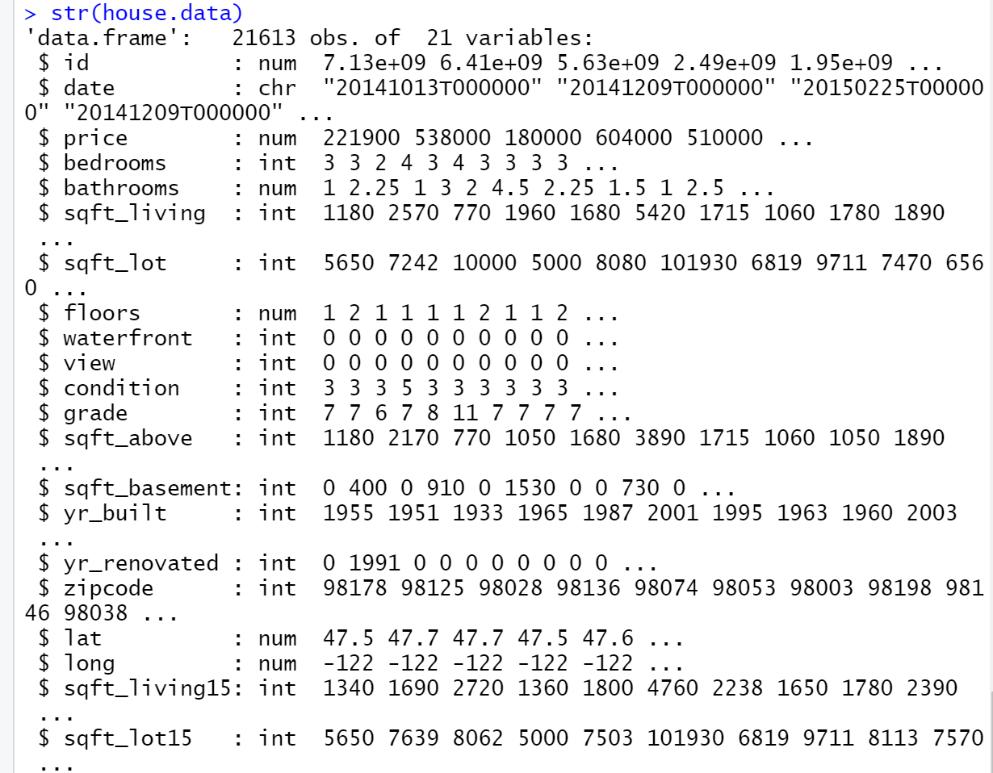
Data understanding

Slide 8
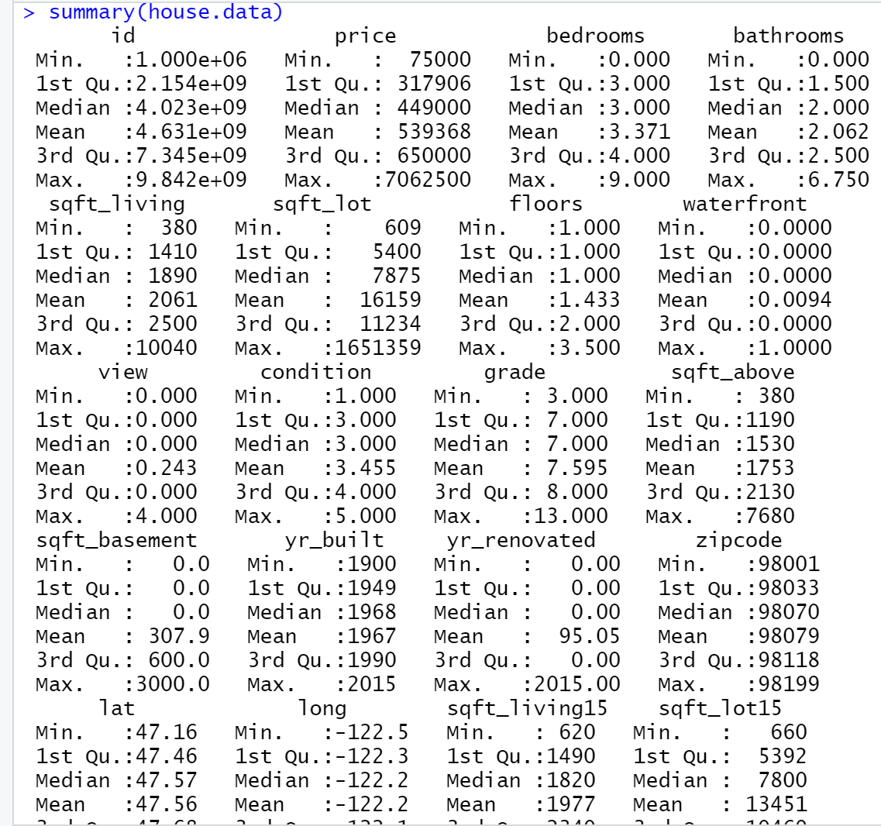
SUMMARY

Slide 9
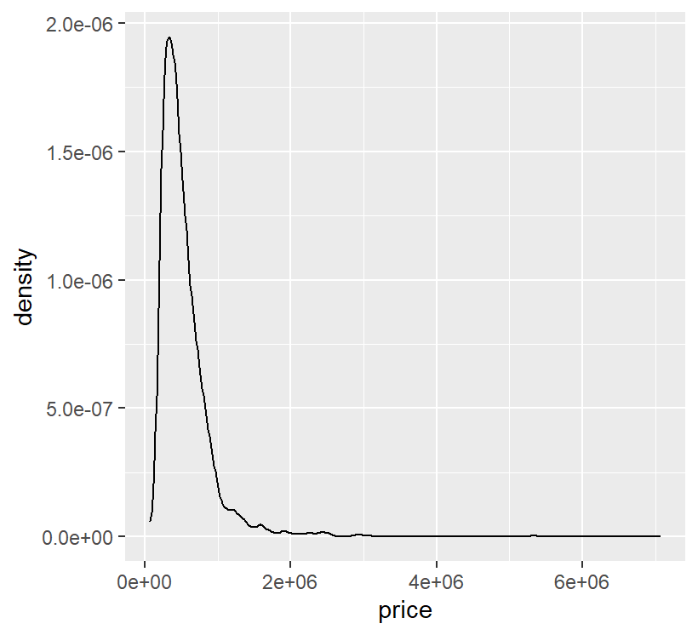
PLOT DENSITY OF THE PRICE
ggplot( house.data, aes(x = price)) + geom_density()
We can see that the prices for most houses lie between 75.000 and 1.5 million dollars. There are few extreme values of up to 7.7 million dollars.

Slide 10
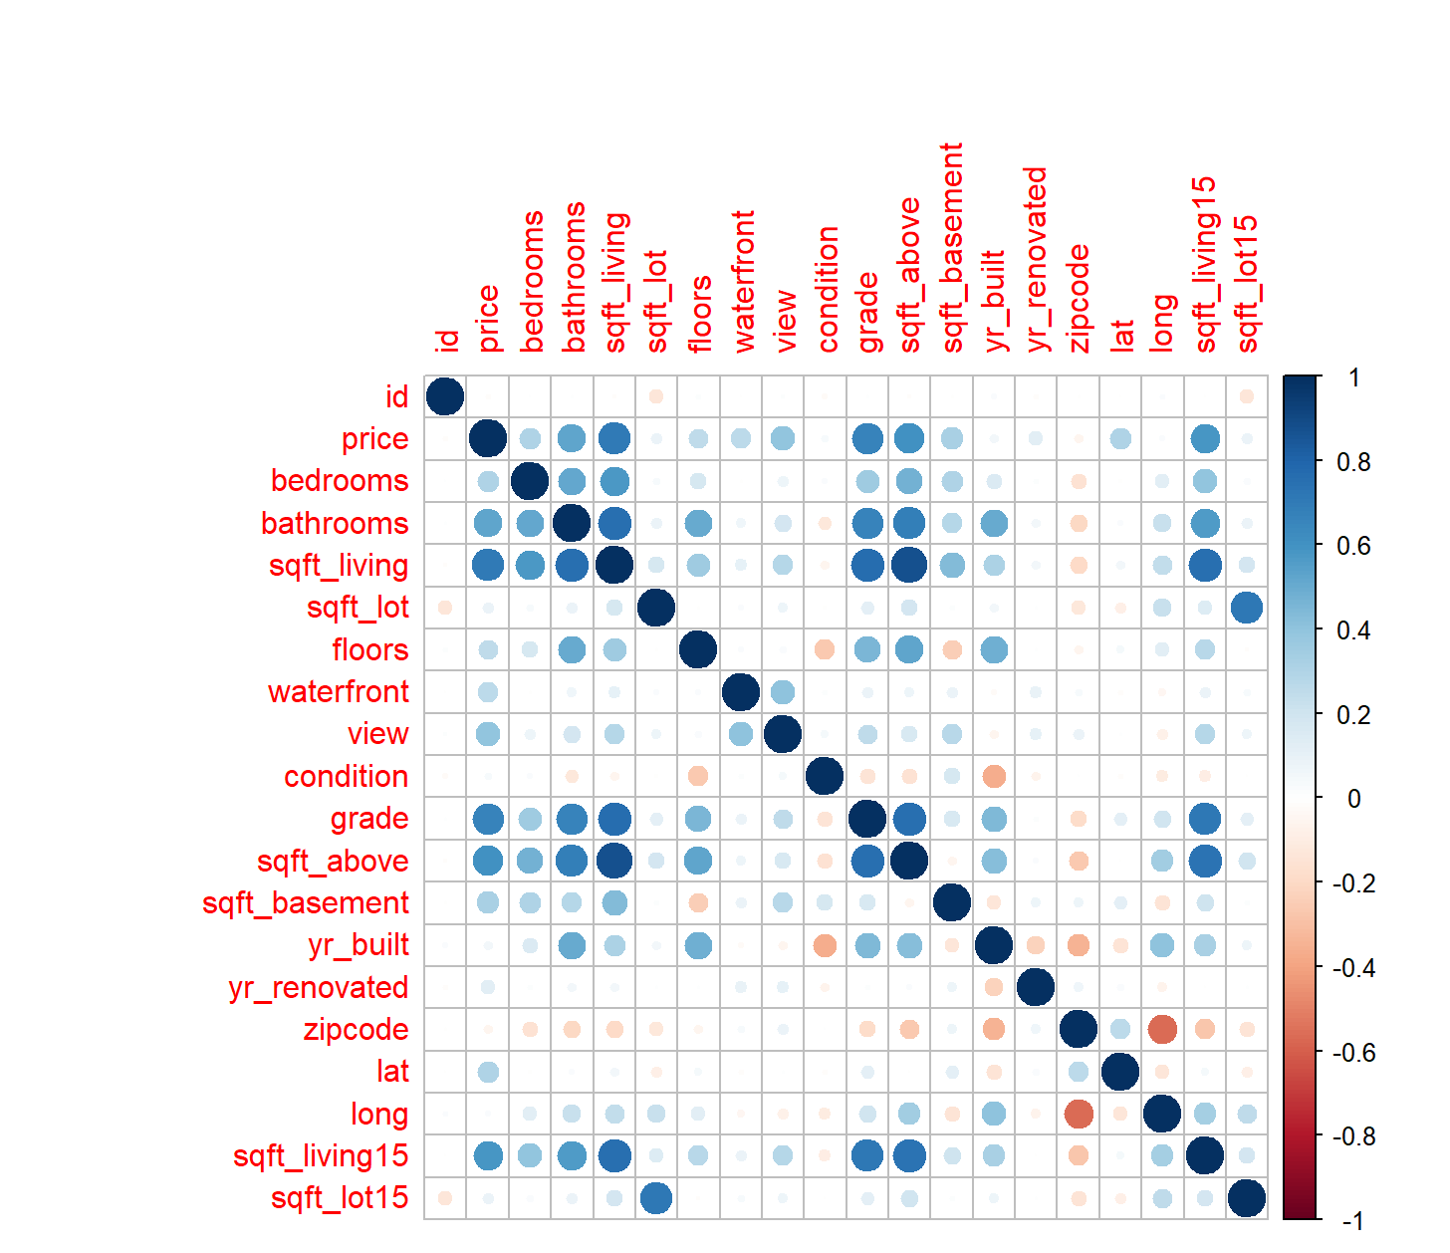
From the correlation matrix, these are the findings:-
Price has a high positive correlation with number of bathroom, sqft_living, grade, sqft_above, and sqft_living15.
Price has low positive correlation with number of bedroom, floors, waterfront, view, sqft_basement and latitude.
Price has non significant relationship with sqft_lot, condition, yr_built, yr_renovated, zipcode, longitude, sqft_lot15, age, and renovated.
sqft_above, sqft_living15, number of bathroom, number of bedroom, grade and sqft_above show high positive correlation with sqft_living and may explain the same variation in Price as sqft_living.

Slide 11
LOCATION

Slide 12
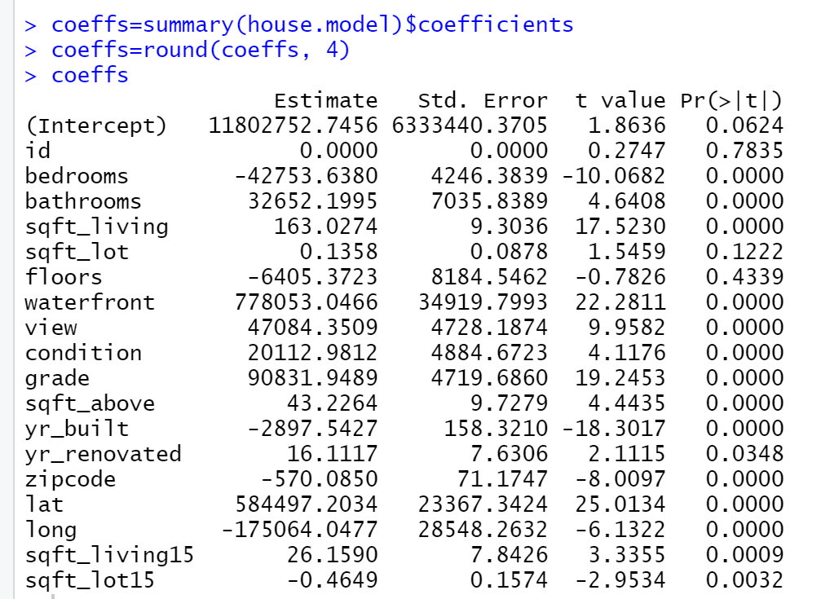
REGRESSION
Notes:
Every one unit increase in waterfront variable adds about seven adds about seven hundred and seventy eight thousand dollar to the property’s price

Slide 13
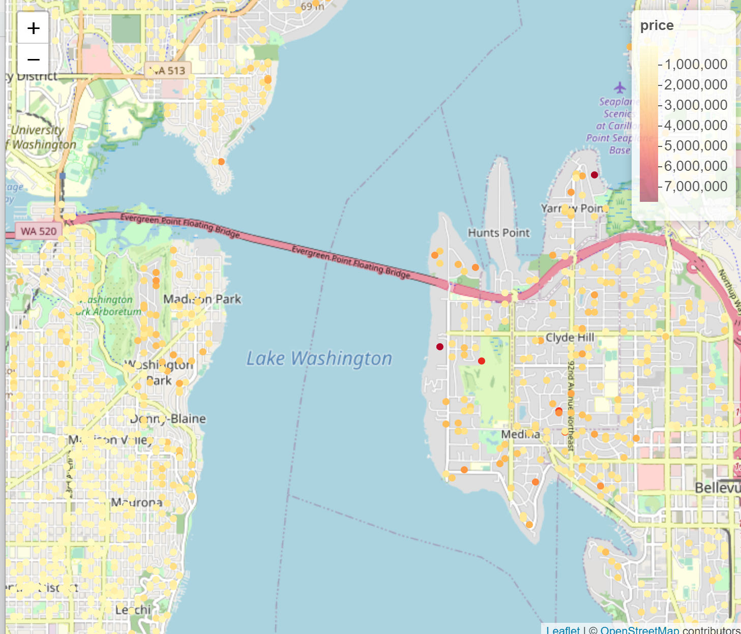
Waterfront living is key, prices rise with houses near waterfront.
Medina, Clyde Hill and Mercer Island are the most expensive neighbourhoods.

Slide 14
House Features

Slide 15
From the correlation matrix, these are the findings:-
Price has a high positive correlation with number of bathroom, sqft_living, grade, sqft_above, and sqft_living15.
Price has low positive correlation with number of bedroom, floors, waterfront, view, sqft_basement and latitude.
Price has non significant relationship with sqft_lot, condition, yr_built, yr_renovated, zipcode, longitude, sqft_lot15, age, and renovated.
sqft_above, sqft_living15, number of bathroom, number of bedroom, grade and sqft_above show high positive correlation with sqft_living and may explain the same variation in Price as sqft_living.

Slide 16
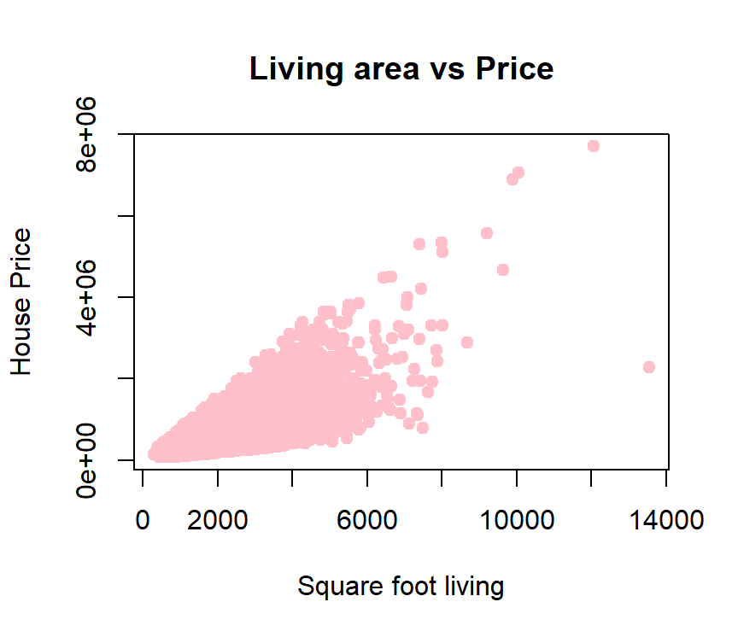

Slide 17
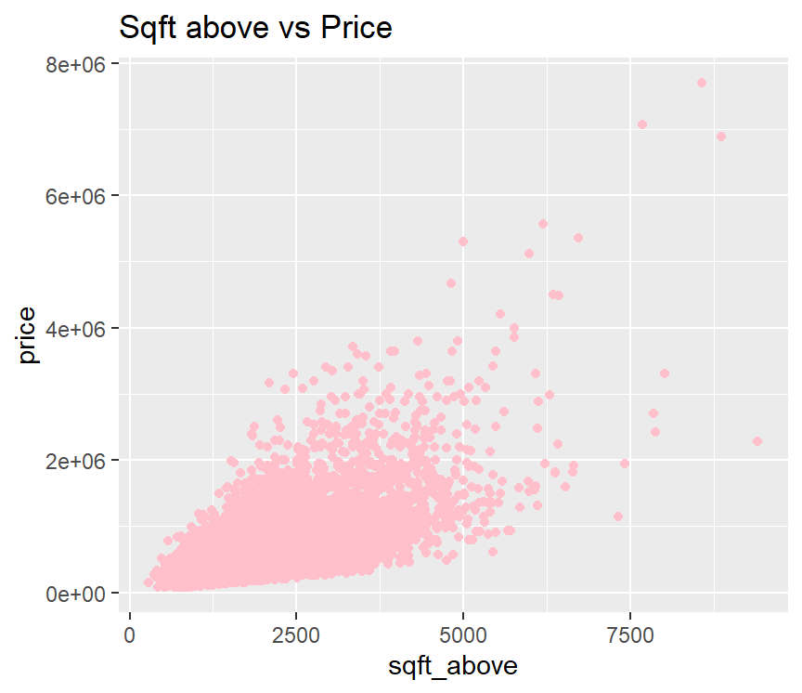

Slide 18
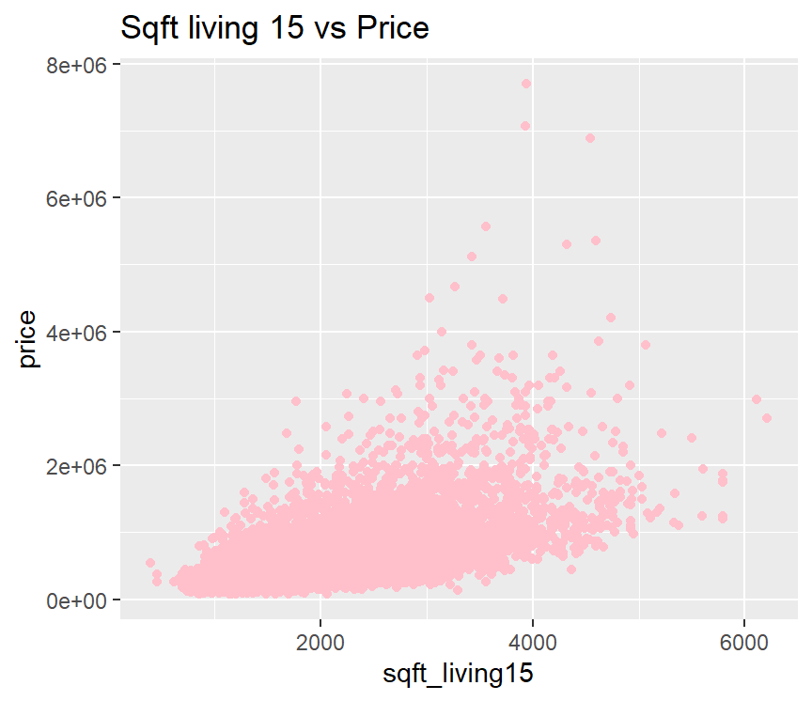

Slide 19
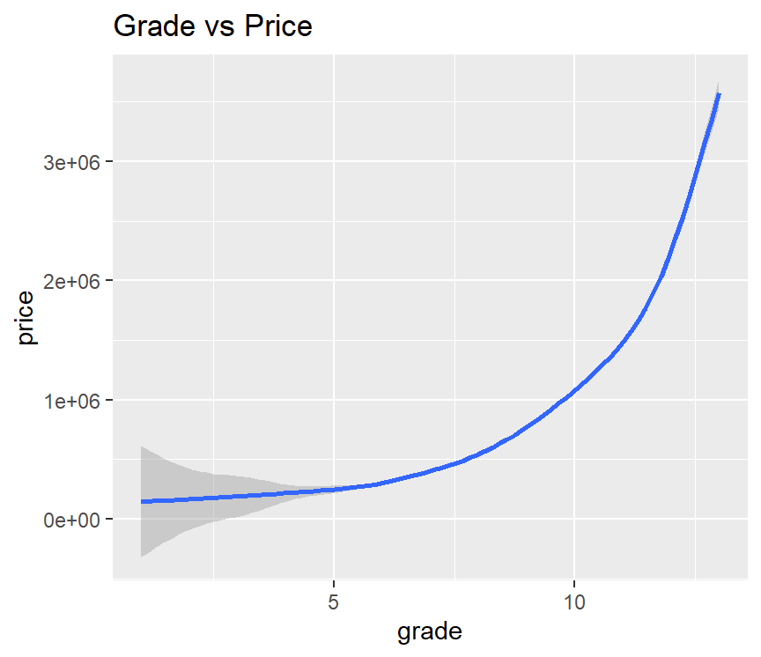
Building grade is a feature from King County government and represents the construction quality of improvements. Details were found here and reproduced below. Grades run from grade 1 to 13. Generally defined as:
1-3 Falls short of minimum building standards. Normally cabin or inferior structure.
4 Generally older, low quality construction. Does not meet code.
5 Low construction costs and workmanship. Small, simple design.
6 Lowest grade currently meeting building code. Low quality materials and simple designs.
7 Average grade of construction and design. Commonly seen in plats and older sub-divisions.
8 Just above average in construction and design. Usually better materials in both the exterior and interior finish work.
9 Better architectural design with extra interior and exterior design and quality.
10 Homes of this quality generally have high quality features. Finish work is better and more design quality is seen in the floor plans. Generally have a larger square footage.
11 Custom design and higher quality finish work with added amenities of solid woods, bathroom fixtures and more luxurious options.
12 Custom design and excellent builders. All materials are of the highest quality and all conveniences are present.
13 Generally custom designed and built. Mansion level. Large amount of highest quality cabinet work, wood trim, marble, entry ways etc.

Slide 20
Time

Slide 21
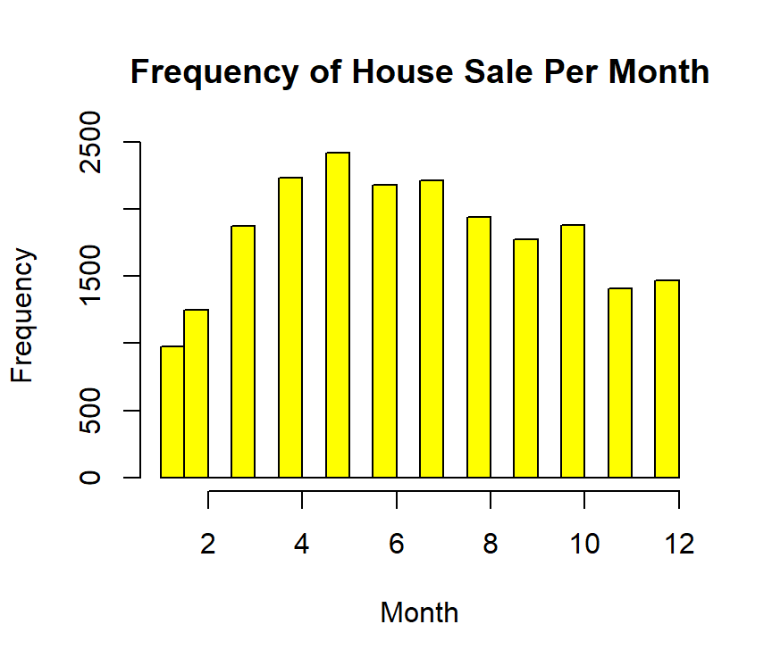
April and May are the most popular months for house sales. In contrast, January and February have the lowest number of sales.

Slide 22
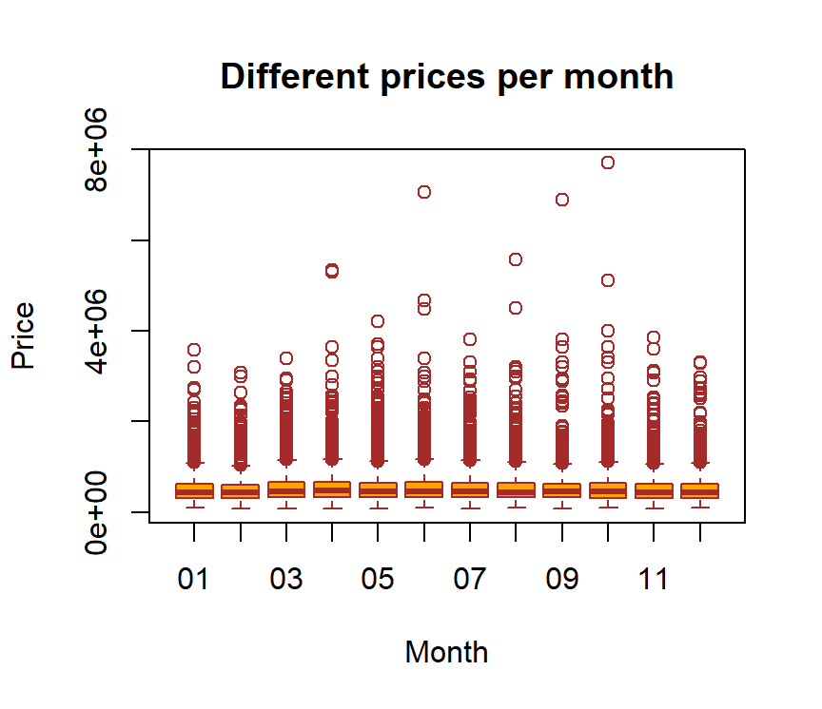
Prices are pretty stable during the year.

Slide 23
Modeling

Slide 24
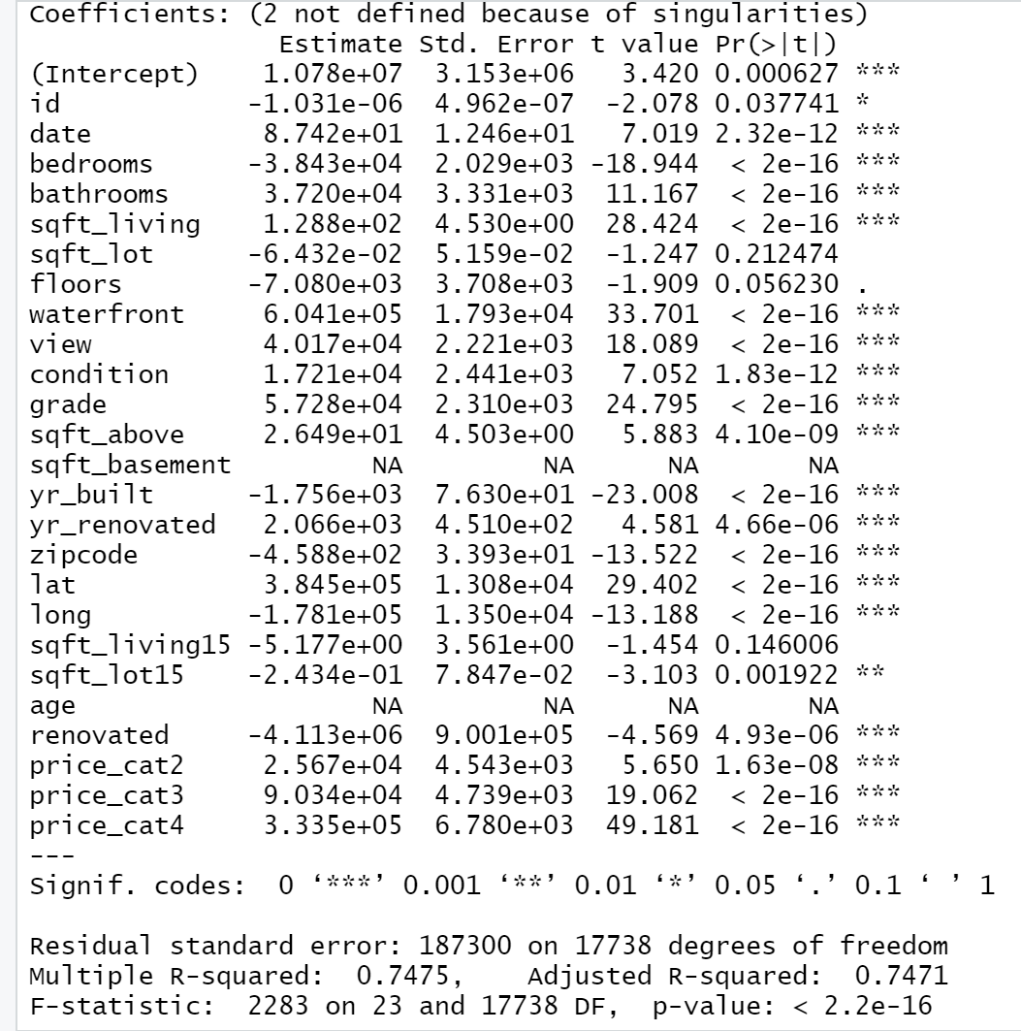
Predictive Model

Slide 25
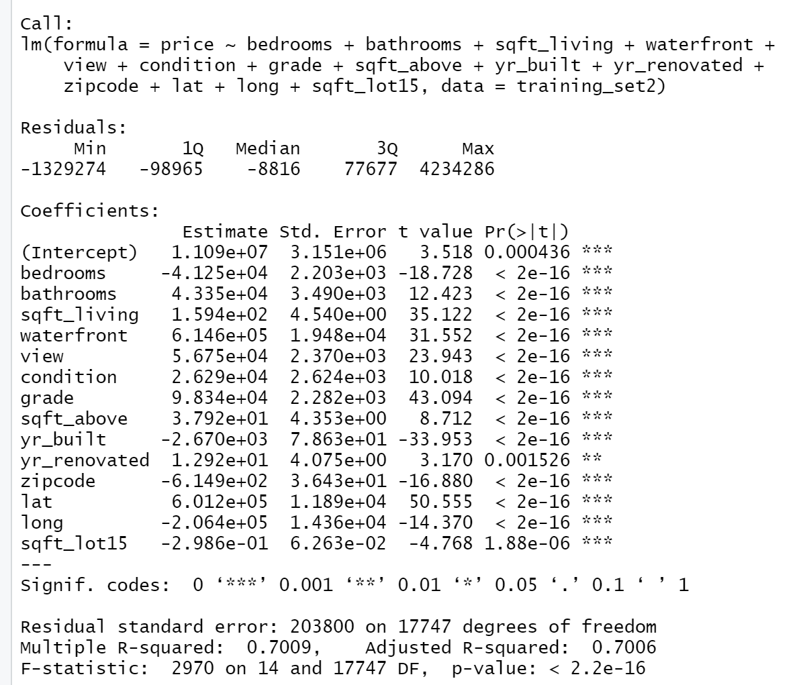
Remove the individual variables that are not significant to the output like ID, Date, sqft_lot,floors,sqft_basement,sqft_living15, Age and Price categories. Start the back-elimination method to find the best combination of variables.
Notes:
The R2 metric indicates that only 38% of the variance can be explained by our model. The coefficent of sqft_living is 202, which means that for every additional square-foot of living area, the price increases by USD 202. In other words, house A with living area 1,000 sqft larger than house B will cost around USD 200,000 more, all other features equal.

Slide 26
 | Linear Regression | Decision Tree
Features | 14 | 4
R-Squared
Matrix | Correlations | Yhat and square root of MSE
MSE | 2148.843 | 69390389922

Slide 27
CONCLUSION
Location
House Features
Month
Houses near waterfront have higher prices.
Medina, Clyde Hill and Mercer Island are the most expensive neighborhoods.
Larger houses have higher prices.
Grade is a good predictor.
House prices are stable during the year.
April and May has the highest sales volumn.
Together, square footage, grade, number of bathrooms, and the size of neighbors’ homes function as the best predictors of a house’s price in King County.

Slide 28
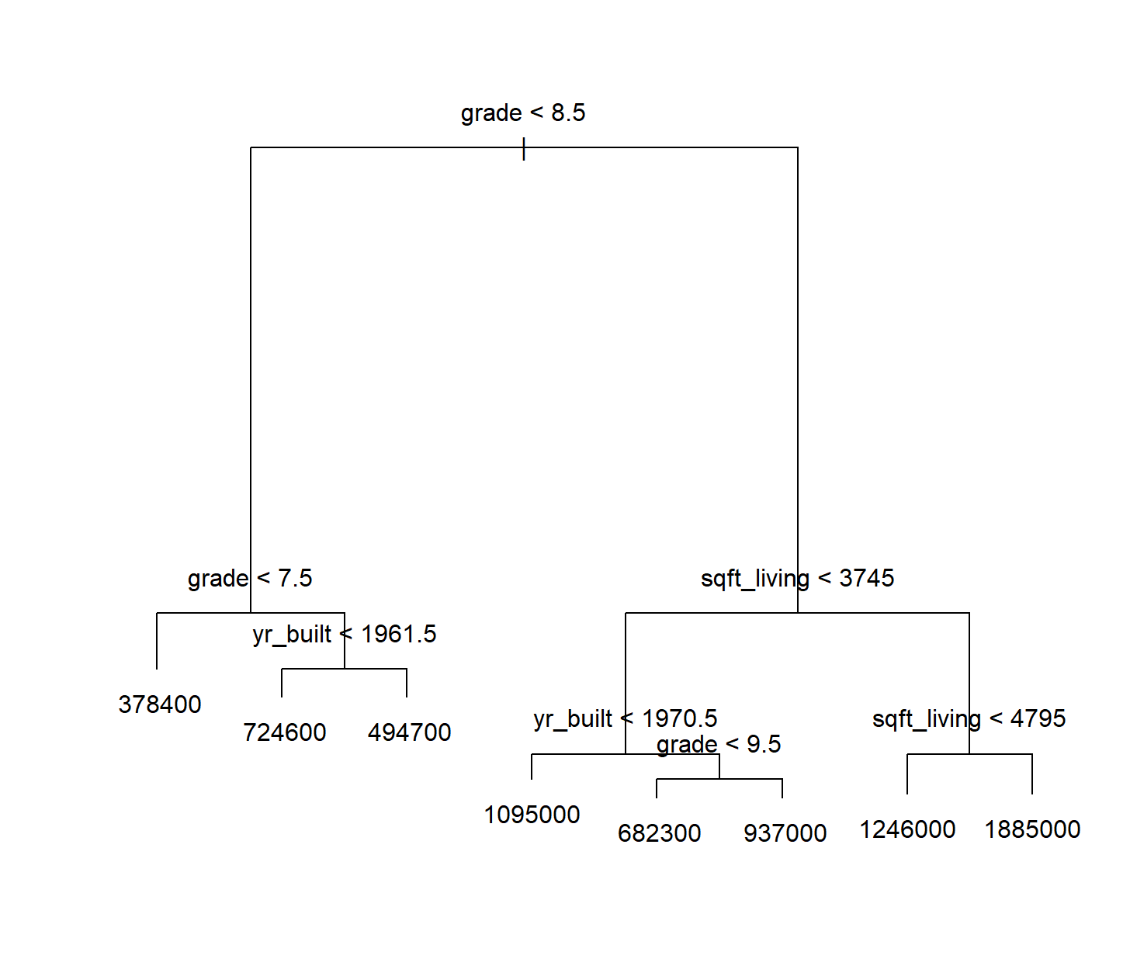
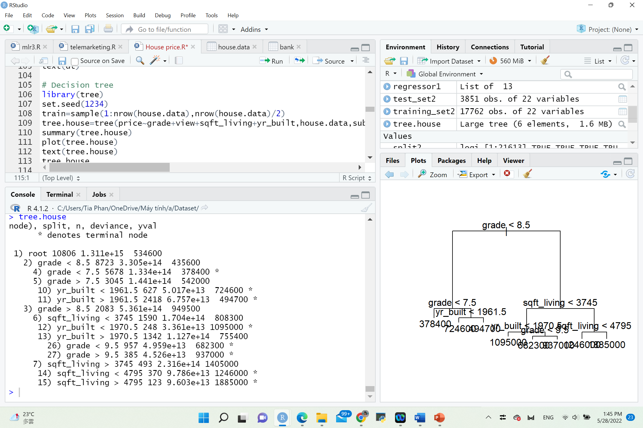
Decision Tree

Slide 29
RESOURCES
mlr-org: House Prices in King County
mlr3cheatsheets/mlr3.Rmd at main · mlr-org/mlr3cheatsheets · GitHub

Slide 30
THANKS
Does anyone have any questions?
addyouremail@freepik.com
+91 620 421 838
yourcompany.com

